Slide 1
Part of Speech Tagging
Using Part of Speech to extract Meaningful Keywords

Slide 2
What is Part of Speech?
Part of speech indicates how the word functions in meaning as well as grammatically within the sentence
An individual word can function as more than one part of speech when used in different circumstances
Understanding parts of speech is essential for determining the correct definition of a word when using the dictionary
Eight Part of Speech (POS) in the English language: noun, pronoun, verb, adjective, adverb, preposition, conjunction, and interjection

Slide 3
Stanza by Stanford NLP
Uses neural pipeline
Provides pretrained NLP models for a total of 66 human languages including Indonesian, Chinese(simplified), Chinese(traditional), Tamil and Telugu
Uses Universal Dependencies (UD) models, which are trained on the UD treebanks
For each word in a sentence, Stanza assigns it a POS
To predict POS, it adopts a bidirectional long short-term memory network (Bi-LSTM) as the basic architecture

Slide 4
Universal Part of Speech Tags
ADJ: adjective
ADP: adposition
ADV: adverb
AUX: auxiliary
CCONJ: coordinating conjunction
DET: determiner
INTJ: interjection
NOUN: noun
NUM: numeral
Source: https://universaldependencies.org/u/pos/
PART: particle
PRON: pronoun
PROPN: proper noun
PUNCT: punctuation
SCONJ: subordinating conjunction
SYM: symbol
VERB: verb
X: other

Slide 5
Adjective
An adjective is a word used to modify or describe a noun or a pronoun
The young girl asked her mother to bring her to the beach at Sentosa for a picnic and then she quickly hid under the blanket. Wow!

Slide 6
Adverb
An adverb describes or modifies a verb, an adjective, or another adverb
It usually answers the questions of when, where, how, why, under what conditions, or to what degree
Adverbs often end in –ly
The young girl asked her mother to bring her to the beach at Sentosa for a picnic and then she quickly hid under the blanket. Wow!

Slide 7
Noun
A noun is the name of a person, place, thing or idea
The young girl asked her mother to bring her to the beach at Sentosa for a picnic and then she quickly hid under the blanket. Wow!

Slide 8
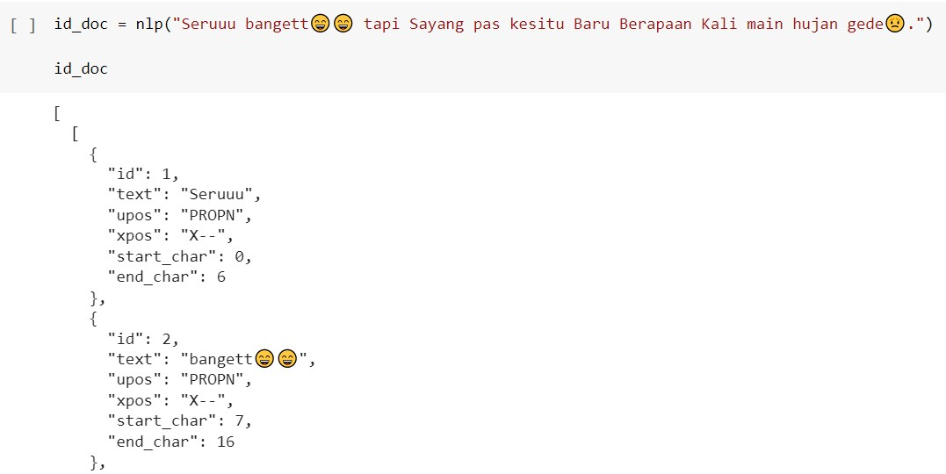
How does Stanza Annotate?

Slide 9
Unigrams
Part of Speech | Indonesian | English
Adjectives | puas lama nak murah panas ampun keren lengkap luas nyaman | satisfied long nice inexpensive hot sorry cool complete large comfortable

Slide 10
Bigrams
Part of Speech | Indonesian | English
Adverb + Adjective | sangat lengkap sangat nyaman cukup mahal lebih baik terlalu besar kadang jengkel juga bersih sangat bagus juga enak lebih seru | very complete very comfortable quite expensive better too big sometimes annoyed also clean very good also delicious more fun

Slide 11
Trigrams
Part of Speech | Indonesian | English
Adverb + Adjective + Noun Noun + Adverb + Adjective | paling seru transformer sangat spektakuler tempat sangat wow tempat kurang pas anak sangat bersih disini paling keren 3d lumayan mahal tempat sagat bagus tempat sangat rekomended pengalaman lumayan moderen pertunjukan | the most exciting transformer very spectacular place very wow place not fitting for children very clean here the coolest 3d pretty expensive place really good place very recommended experience pretty modern show

Slide 12
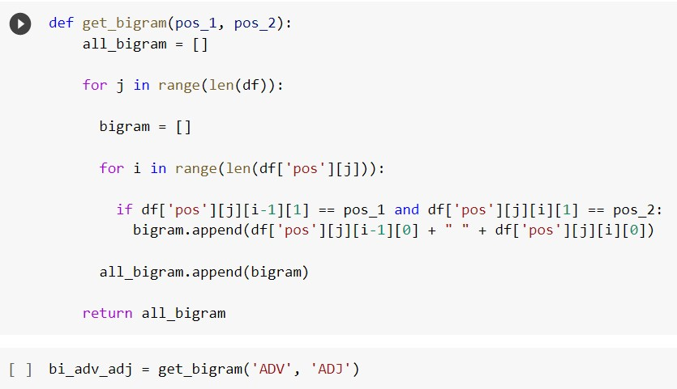
Code to get Bigrams

Slide 13
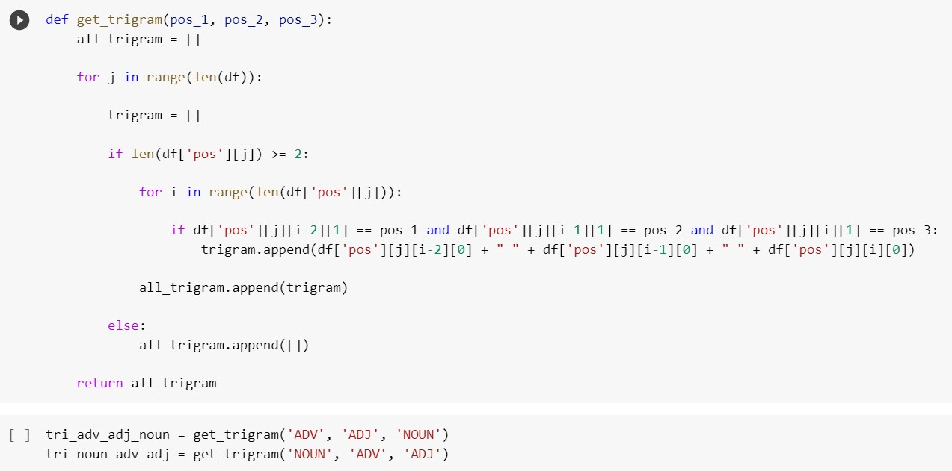
Code to get Trigrams

